Slide 1
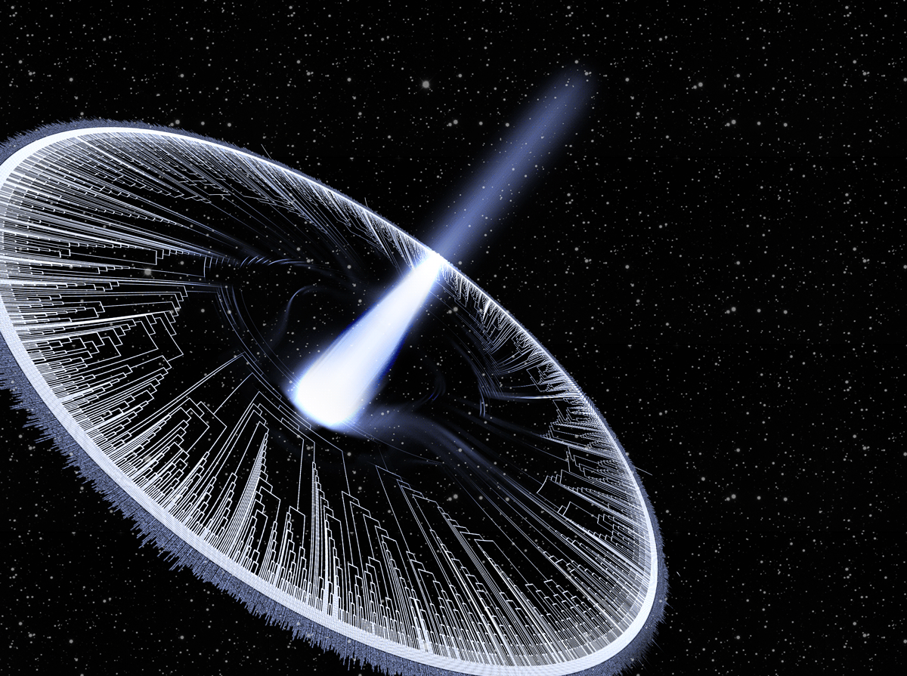
The macroevolutionary dynamics of adaptive landscapes
Josef C Uyeda

Slide 2
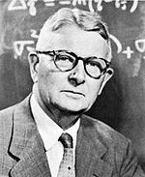
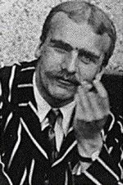
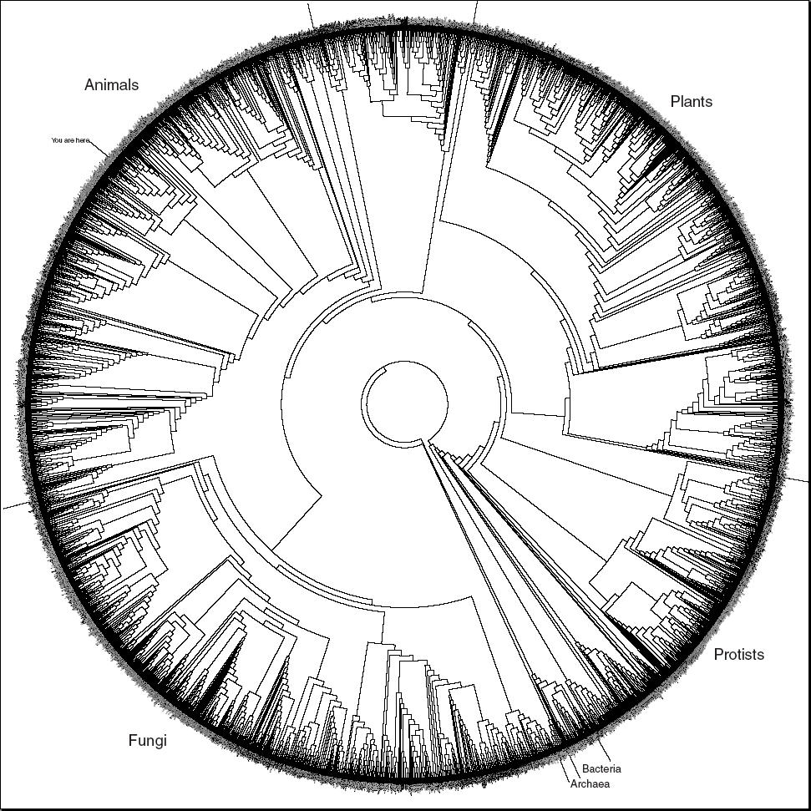
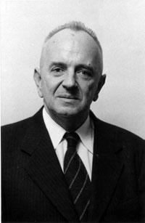
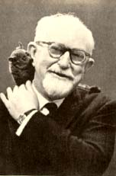
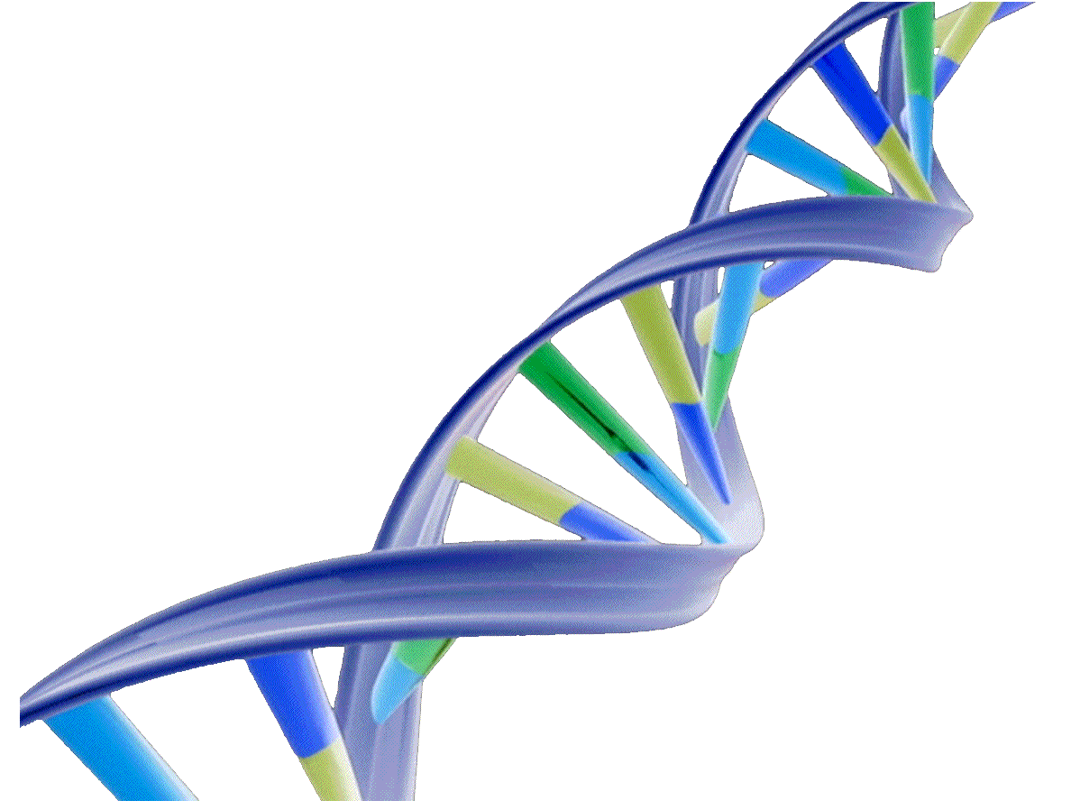
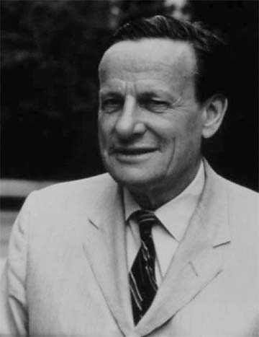
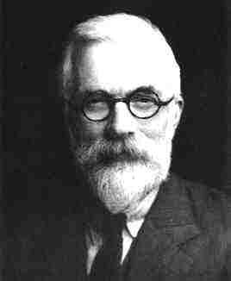
Reductionism & the Modern Synthesis
Wright
Haldane
Dobzhansky
Simpson
“Change in allele frequency over time”
Stebbins
Fisher

Slide 3
Outline
Are micro and macroevolution in conflict?
How can we study macroevolution using realistic models of adaptation and evolution?
Using bayou

Slide 5
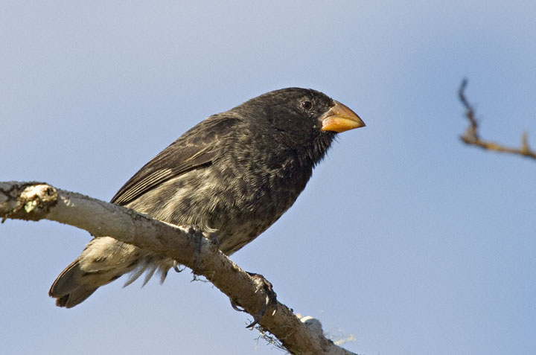
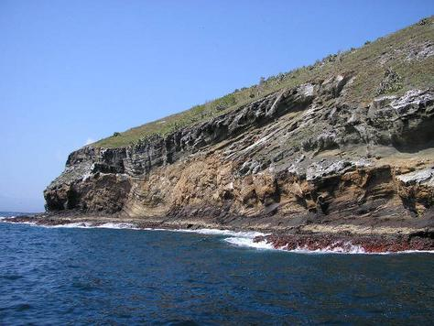
Microevolutionary patterns
We now know that we can study evolution in real time
Average weight
16.06 g
(1976)
17.13 g
(1978)
Response to selection
6.7% ∆ body size in
1 generation (2 years)
Let’s assume only 1% is evolutionary
(Grant and Grant, 2002)

Slide 7
Let’s do the calculations:
If a population increased by 1% every generation starting from ~16 g:
In 200 years
43 g
In 500 years
193 g
In 1,000 years
2.3 kg
In 2,000 years
335 kg
In 10,000 years
6.47 x 10¹⁹ kg

Slide 8
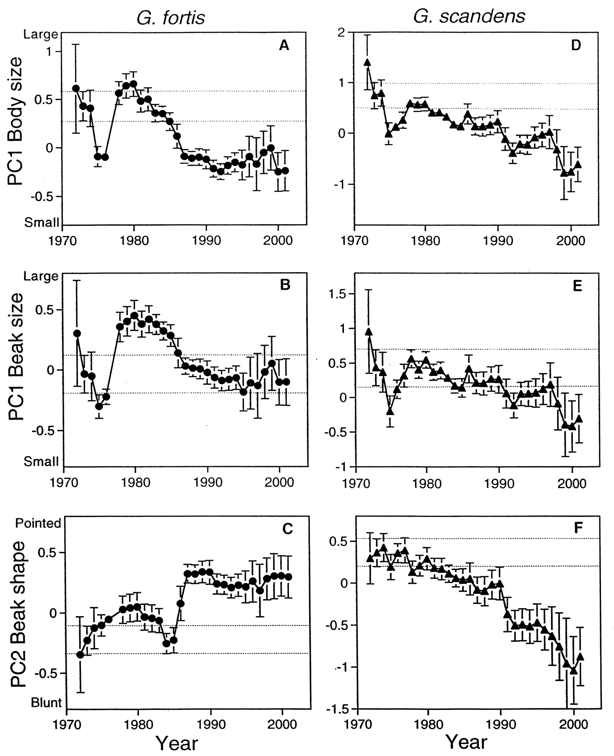
But evolution often reverses itself!
Let’s instead simulate going up or down randomly
(Brownian motion)
(Grant and Grant, 2002)

Slide 9
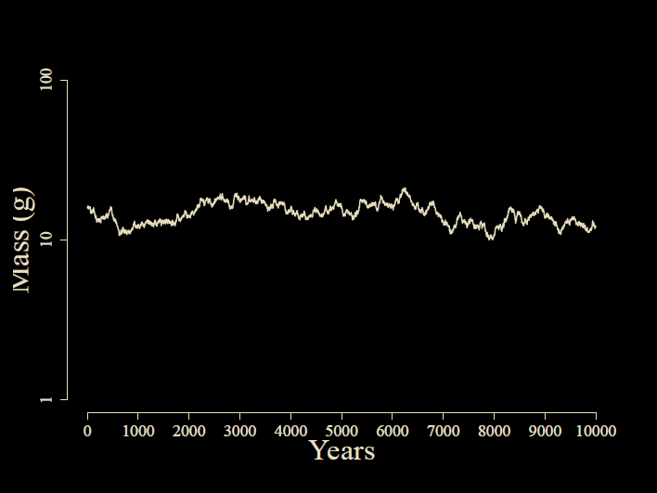
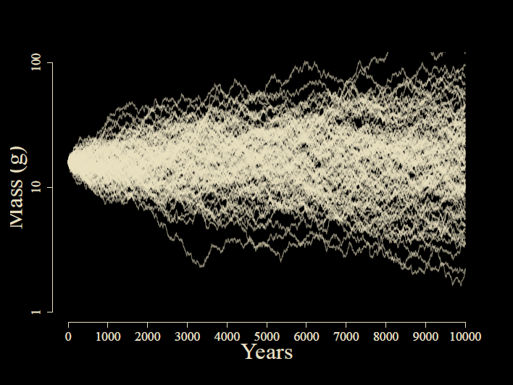
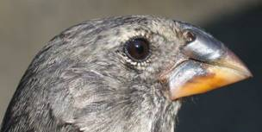

Slide 10
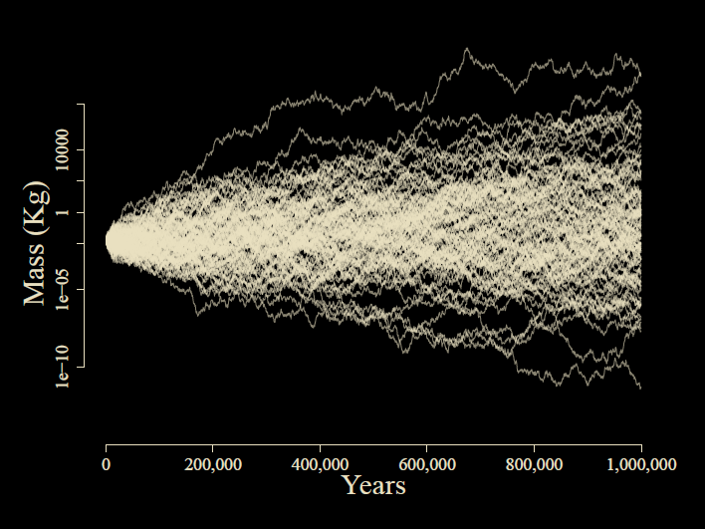

Slide 11

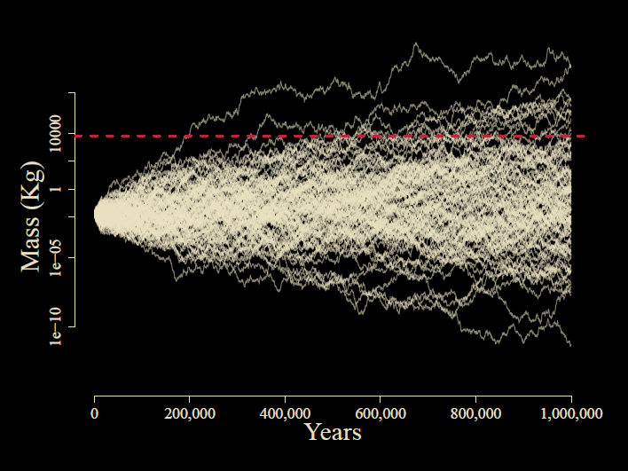

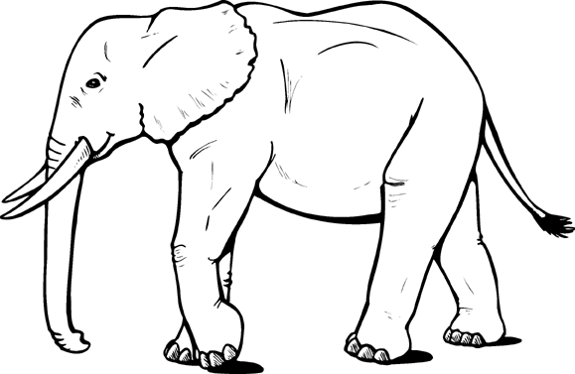
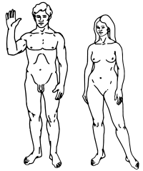
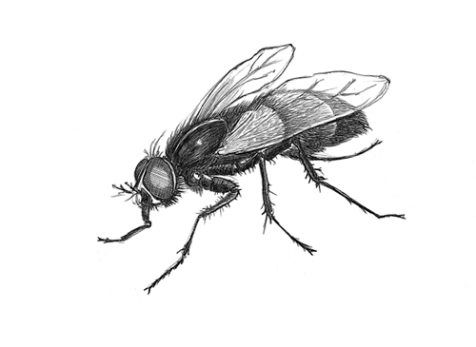
Notes:
1% change in a trait: minor in microevolution
But on macroevolutionary scale: waaay too big

Slide 12
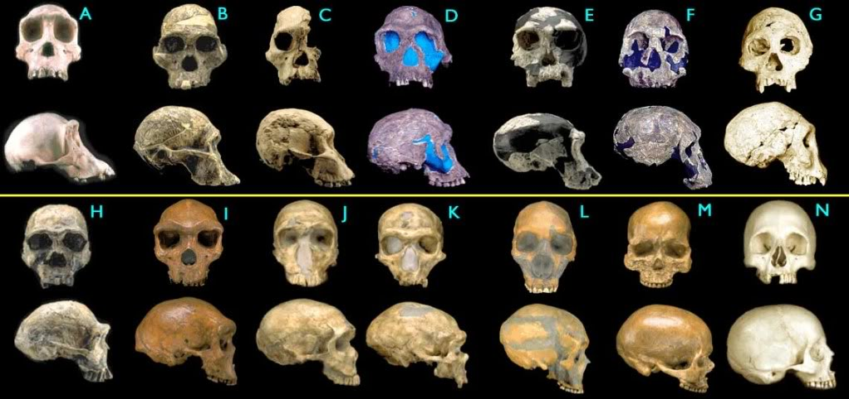
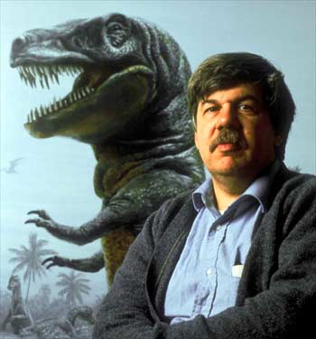
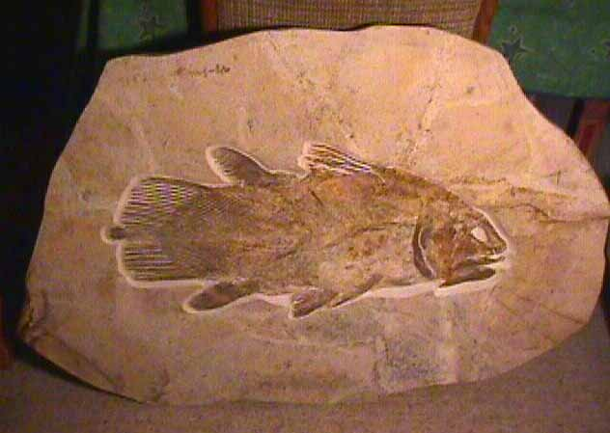
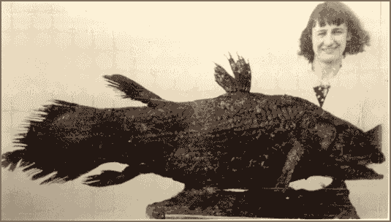
What does the fossil record say?
The pattern is stasis
Stephen Jay Gould
Notes:
Punctuated equlibrium?

Slide 13
The Paradox of Stasis (Hansen & Houle 2004): Organisms seem to be able to evolve far more than they ever do
Empirical studies often find:
Strong (and often persistent) directional selection
(Hereford et al. 2004, Morrissey & Hadfield 2012)
High levels of additive genetic variance
(Mousseau & Roff 1987, Houle 1992)
Rapid evolutionary rates
(Hendry & Kinnison 1999, Kinnison & Hendry 2002)
…yet stasis in the fossil record
(Gingerich 1983, 2002)
Notes:
Perhaps headlines from Kingsolver’s paper?

Slide 14
Does microevolution even matter for long-term change?

Slide 15
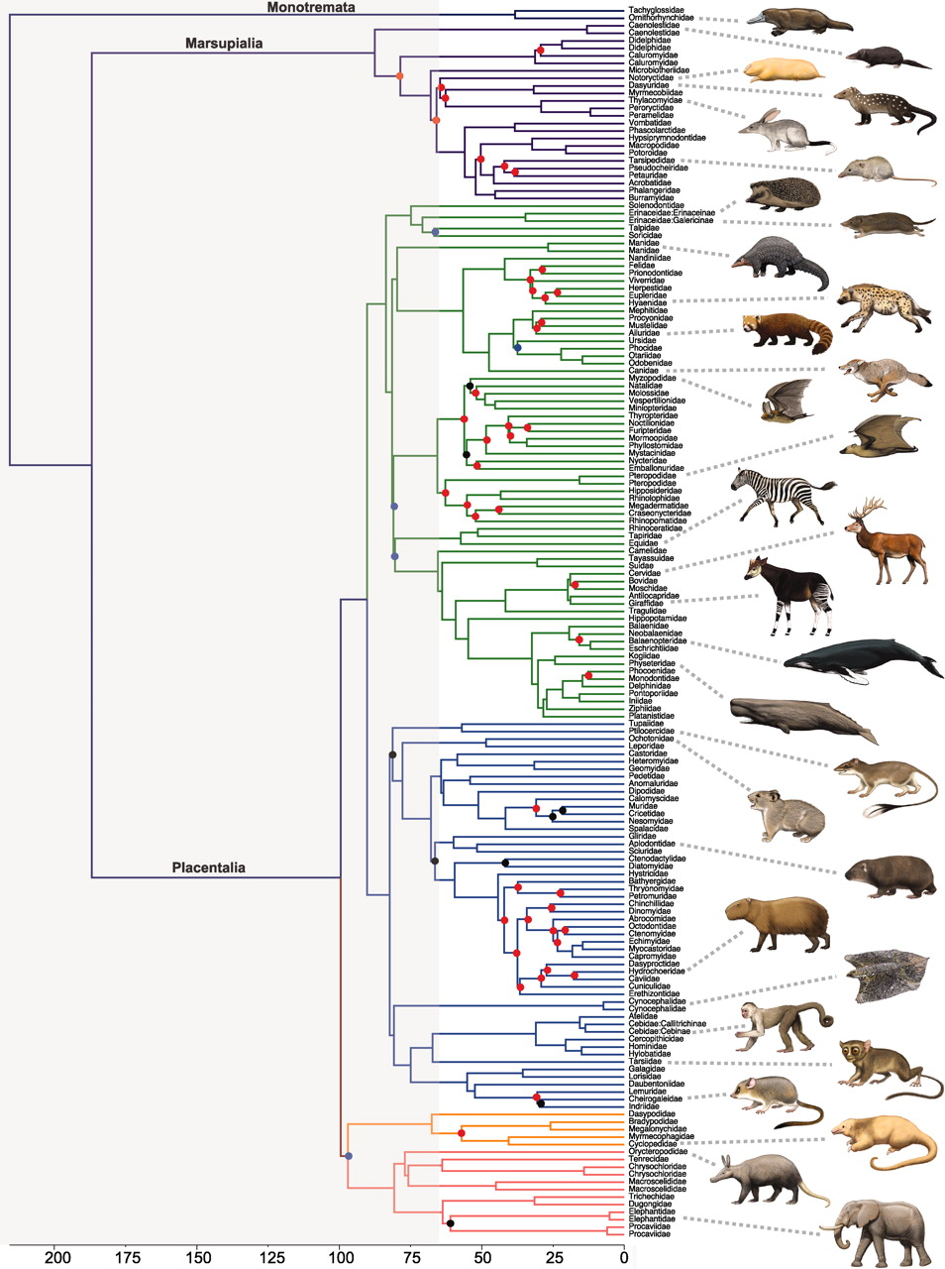
So what do comparative biologists use to model evolution on a phylogeny?
Patterns in phylogenetic comparative data
Gradual Brownian motion!
Notes:
Scaling across the tree of life however, reveals a dramatic phenotypic diversity, and we find that evolution behaves not too differently than Brownian motion.

Slide 16
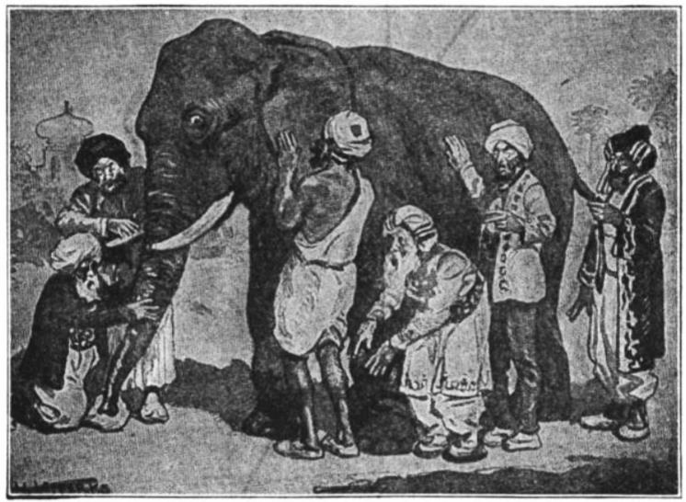
The Elephant in the Dark
Each of us touches one place
And understands the whole in that way.
…
If each of us held a candle there,
And if we went in together,
We could see it.
Notes:
Many of you are probably familiar with the Indian story of the Blind men and the Elephant, or in other versions, the Elephant in the Dark. The story comes in many versions, but the common theme is that a group of men disagrees about the nature of an elephant because they are unable to perceive beyond a small portion of its body. If you will indulge me, I’d like to read a portion of one of my favorite versions of this story, but the Persian Poet Rumi.

Slide 17
How can we see the pattern across scales of time?
All studies of phenotypic evolution measure comparable quantities
Time interval
Time interval
Pop A
mean(z)
Pop B
mean(z)
Pop A
mean(z)
Pop B
mean(z)
Pop X
We measure two quantities:
(1) “time for evolution”
(2) Δ mean body size
Notes:
Luckily, regardless if you are a paleontologist, a field biologist or a comparative biologist, you basically study the same thing. We have two populations, separated by time, and we measure a change in mean.

Slide 18
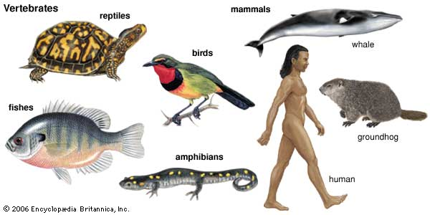
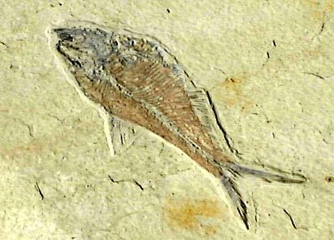

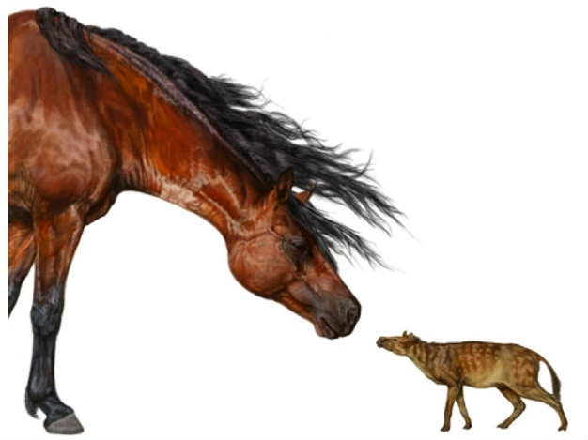
Phenotypic divergence database (Uyeda, Hansen, Arnold & Pienaar, 2011. PNAS.)
Only animals, mostly vertebrates, but also some inverts
Field, Fossil and Phylogenetic comparative data
Only traits related to linear body size change

Slide 19
>8000 data points from
> 150 studies
Intervals from < 1 yr to 360 my

Slide 20
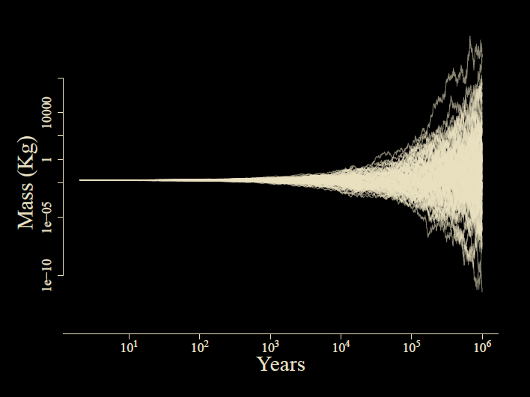

Slide 21
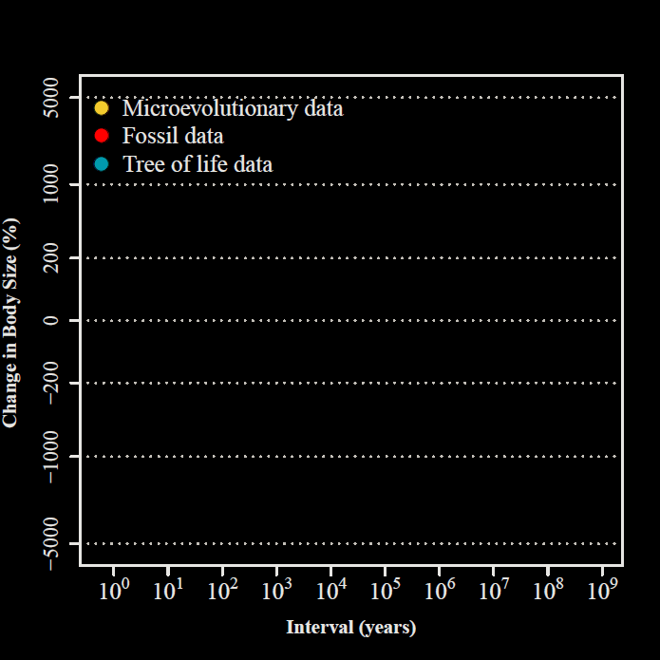
Uyeda et al.,
PNAS, 2011

Slide 22
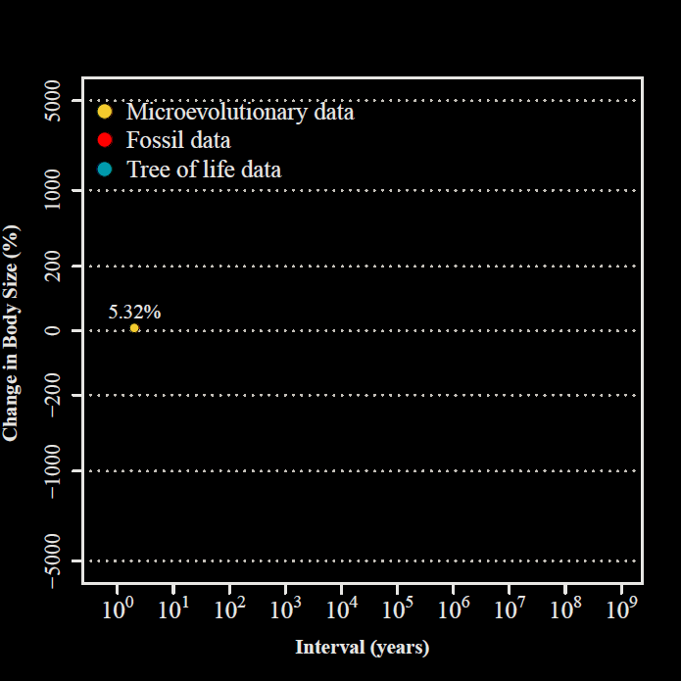
2 years
Uyeda et al.,
PNAS, 2011

Slide 23
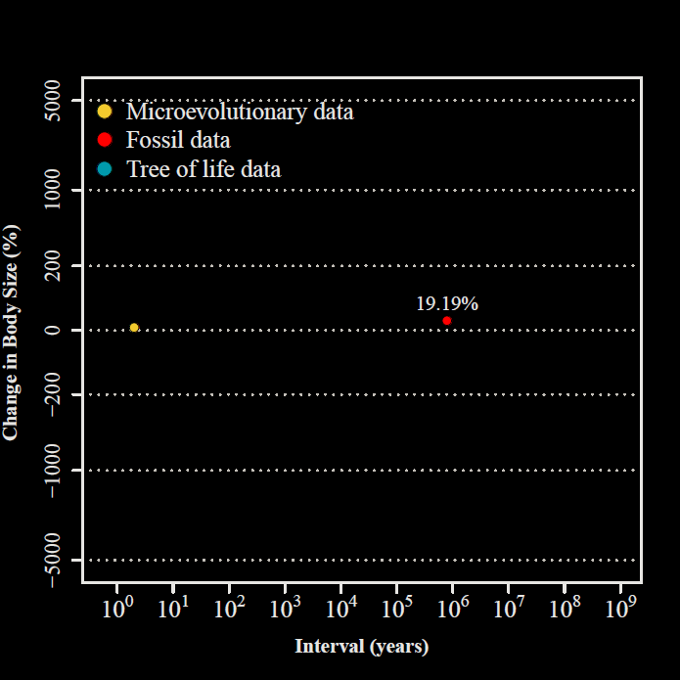
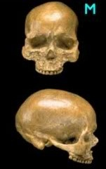
800,000 years
Uyeda et al.,
PNAS, 2011

Slide 24
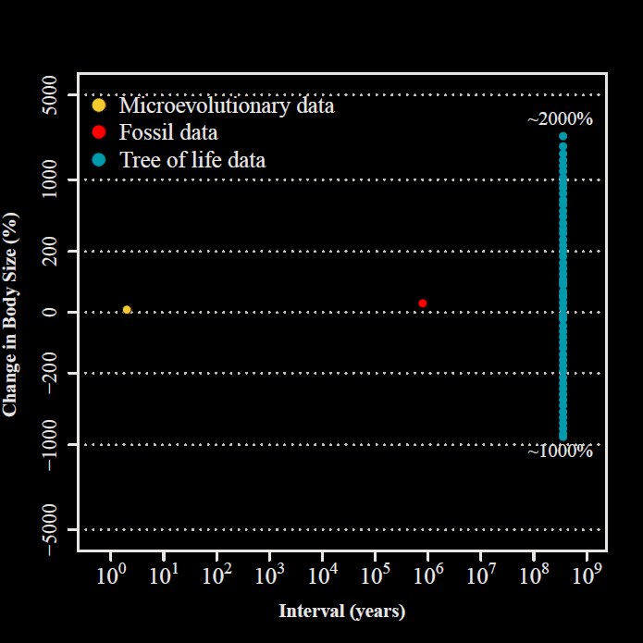
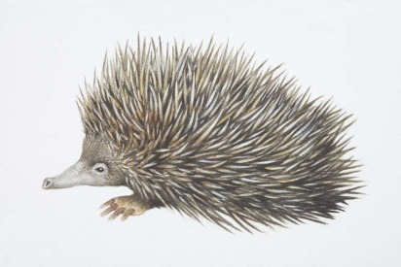
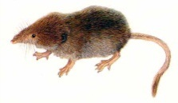
332.4 my

Slide 25
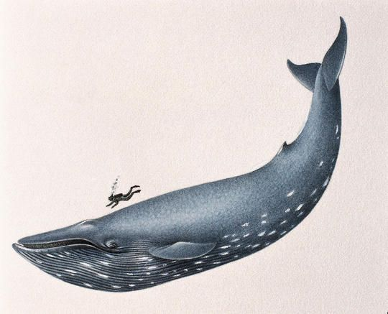
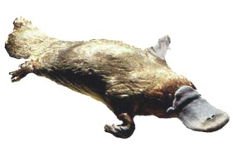
332.4 my
Uyeda et al.,
PNAS, 2011

Slide 26
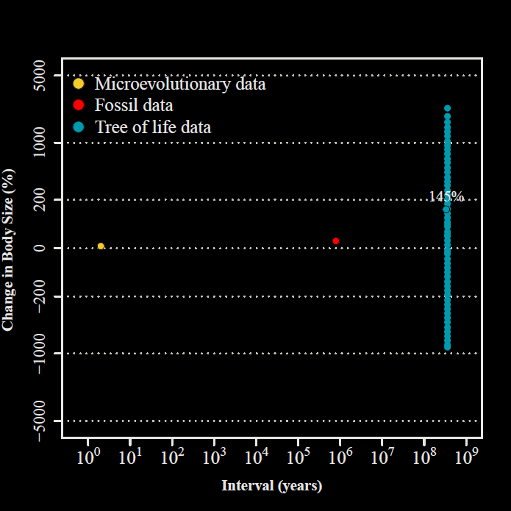
Uyeda et al.,
PNAS, 2011

Slide 27
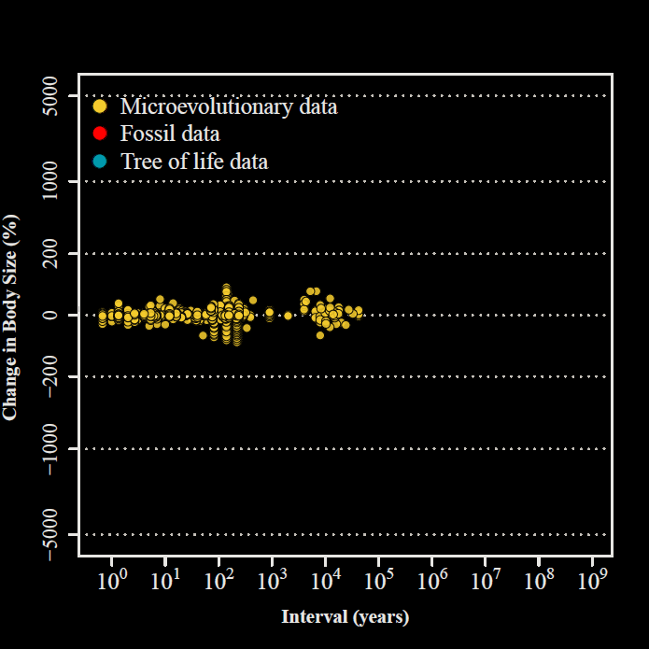
Uyeda et al.,
PNAS, 2011

Slide 28
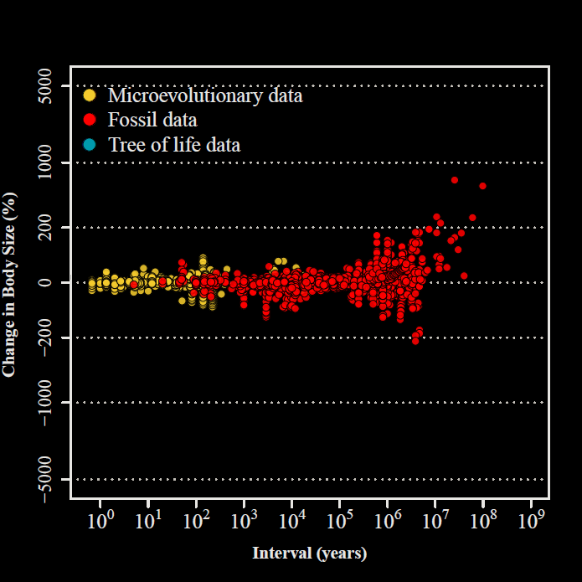
Uyeda et al.,
PNAS, 2011

Slide 29
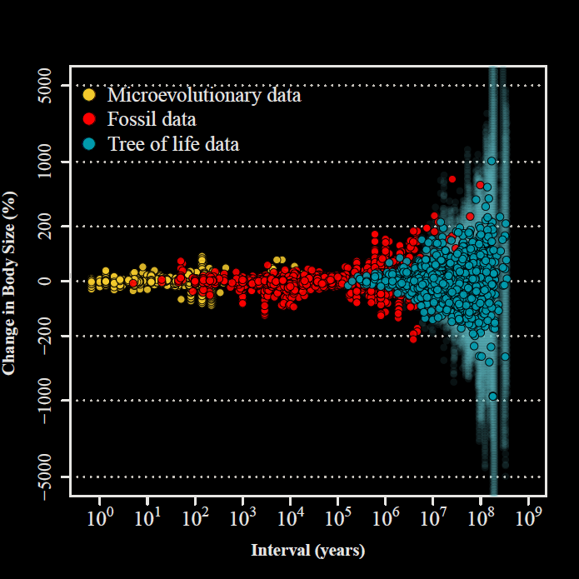

“The Evolutionary Blunderbuss”
Uyeda et al.,
PNAS, 2011
Notes:
So: visualizing the paradox of stasis

Slide 30
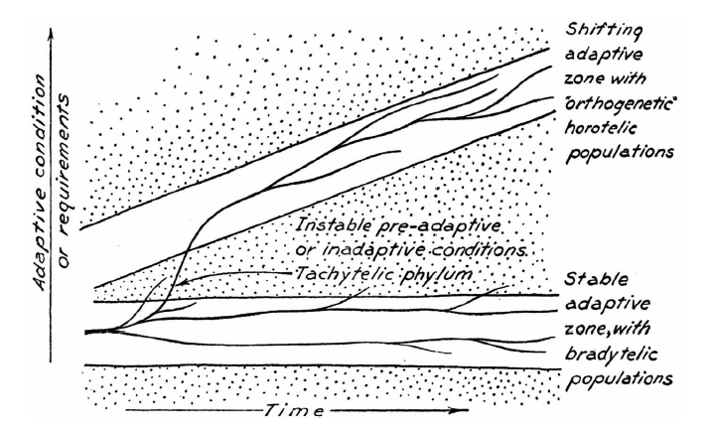
Simpson’s Adaptive Zones

Slide 31
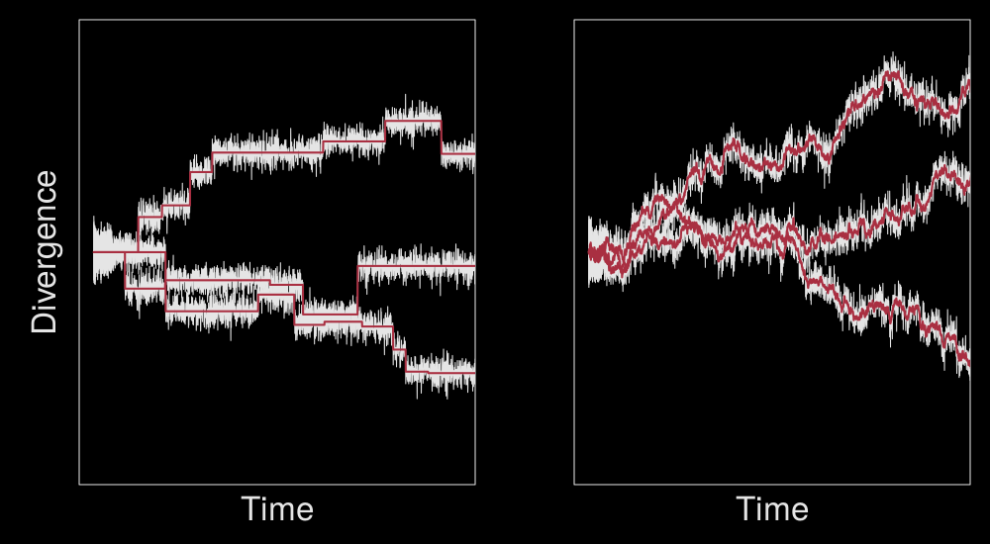
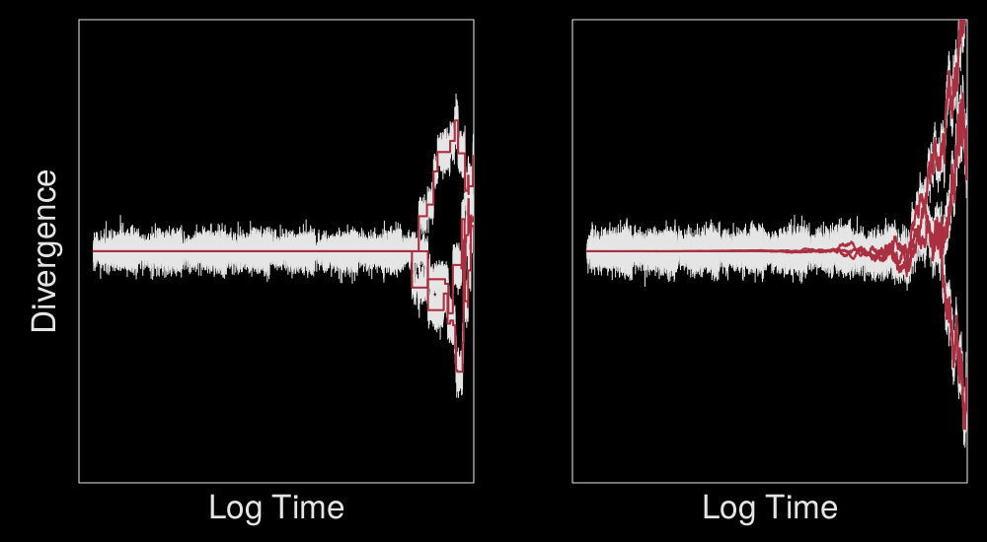
Model fits
Multiple-Burst
(MB)
Brownian Motion
(BM)

Slide 32
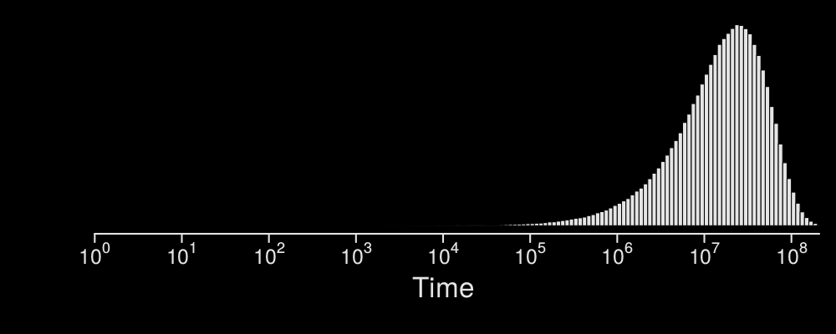
Notes:
Get consistent parameter estimates across timescales – common pattern

Slide 33
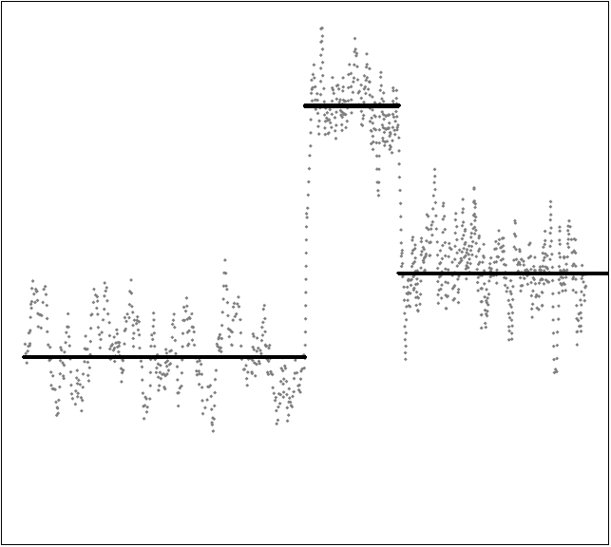
Adaptive peaks move rapidly over short timescales
(Futuyma 1987)
Adaptive peak shifts, stabilizing selection & genetic drift
Phenotype
Adaptive Zones/Niches
Million-year waiting times
Punctuated Equilibrium
Time

Slide 34
Pennell, Harmon & Uyeda. 2013. Is there room for Punctuated Equilibrium in Macroevolution? TREE.

Slide 35
Some recent proposals

Slide 36
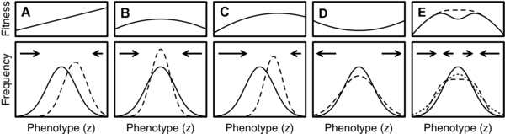
Intraspecific competition
Haller & Hendry. 2014. Solving the paradox of stasis: Squashed stabilizing selection and the limits of detection, Evolution
Notes:
E: squashed stabilizing selection can look like disruptive selection, but just sloshing around a larger adaptive peak

Slide 37
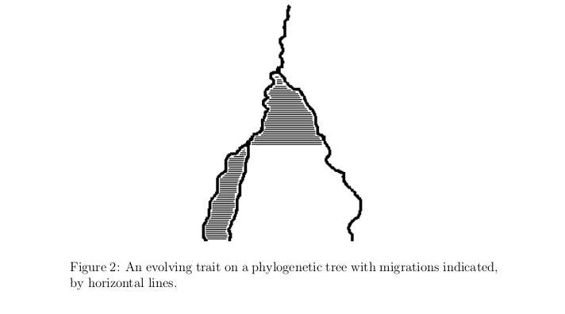
Populations vs. lineages
Bartoszek et al. The Ornstein-Uhlenbeck process with migration: evolution with interactions, arXiv
Notes:
Interactions keep species from diverging too far- delays evolution

Slide 38

Temperature tracking
Hunt et al. 2015. Simple vs complex models of trait evolution and stasis as a response to environmental change, PNAS
Notes:
Or: adaptation tracking abiotic factors

Slide 39


Slide 40

Multivariate genetic constraints
Bolstad et al. 2014. Genetic constraints predict evolutionary divergence in Delachampia blossoms. Phil. Trans. B.

Slide 42
All of the above?
Most of Hansen & Houle’s criticisms of these ideas still hold
…but it’s hard to imagine that they don’t all contribute

Slide 44
The phylogenetic comparative method

Slide 45









Slide 46

Phenotype
Brownian motion

Slide 47


(Hansen 1997, Butler & King 2004)

Slide 48

θ₁
θ₂
θ₃
σ²
α
ln2/α = Phylogenetic Half-Life
Ornstein-Uhlenbeck
(Hansen 1997, Butler & King 2004)
Notes:
Log2/Alpha: phylogenetic half-life, expected time to get to optimum

Slide 49
Compare models
(e.g. by AIC)
Best Model
(Hansen 1997, Butler & King 2004)

Slide 50
Two issues
Best model may still be bad
Model has biological meaning – but lost when applied to comparative data

Slide 52


Notes:
Reversible jump – searches among possible shift patterns
(but doesn’t tell you what is causing the adaptation)

Slide 53

Maddison & FitzJohn 2015
Notes:
Biodiversity time – a curved line through phylogeny

Slide 54

Notes:
Comparative methods: phylogenetic natural history. What pattern do you need to explain?
Descriptive, observational of macro-evolution. Seeing the patterns may be sufficient.

Slide 55
Phylogenetic Natural History

Slide 56





Turtles and Tortoises
(Jaffe et al. 2011)
Marine
Freshwater
Terrestrial
Island
Notes:
High school student! Can you explain turtle body size using their habitat?
Test a priori hypotheses first. Then could explore … in reverse is problematic (trying to explain shifts for the first time after bayou)

Slide 57





(Uyeda and Harmon, 2014)
surface Model
Habitat Model
bayou Model
bayou Model
bayou $θ$: 8 – 167 cm
surface $θ$: 2.9x10⁻¹⁷⁰fm– 1.96x10⁴⁴ km
surface
(Ingram & Mahler, 2012)
Notes:
Circle size- support for switch
Only one shift in this model favors body plan explanation
Surface: like bayou but with a likelihood approach

Slide 58


Slide 59
(Uyeda and Harmon, 2014)
surface Model
Habitat Model
bayou Model
bayou Model
bayou $θ$: 8 – 167 cm
surface $θ$: 2.9x10⁻¹⁷⁰fm– 1.96x10⁴⁴ km
bayou phy. half-life = 3.94 million years
surface phy. half-life = 92 million years

Slide 60



We can generate better hypotheses
Jaffe et al. (2011)
Marine, Freshwater, Terrestrial and Island
Of those, only Marine was found by bayou.
Better hypothesis?
Aquatic life history + high environmental temperature

Slide 61

Anolis
But is it stabilizing selection or adaptive zone shifts or….?
85 taxa
Body size (SVL)
Use 3 different priors:
Weakly informative (Free)
Blunderbuss model (Stasis shifts)
Quantitative genetic model (Peak shifts)

Slide 62
“Blunderbuss” Parameterization
σ²/(2α)
ln2/α

Slide 63

Quantitative Genetics Parameterization (Lande 1976)
$$dZt=−α \left(Z_{t−1} − θ\right)dt+ σ dWt$$
Stabilizing Selection
Genetic Drift
α = h²V_{P}/(V_{P}+ω²)
σ² = h²V_{P}/N_{e}

Slide 64

QG model priors
h² =estimated in anoles to be ~0.55 for body size
V_{P}=estimated from the data
Ne = 99% CI between 1000 and 400,000 (mean 22,000)
ω²= Stabilizing & directional selection gradients estimated from wild populations

Slide 65


Blunderbuss Model
$$θ$$
Crown giants
Trunk/crown
Trunk
Trunk/ground anoles
Bush and twig anoles

Slide 66
Both Blunderbuss and Lande models perform much more poorly than free parameterization
Parameterization | Marginal lnL | 2 ln BF: Free vs. _____
Free | -16.4 | 0
Blunderbuss | -24.9 | 17.0
Lande (QG) | -37.7 | 21.3
Can also combine these interpretations with ecotype-based hypotheses…..

Slide 67
Convergent, Ecomorph-based regimes fit tree best, but should not be interpreted as either Blunderbuss or Lande model
Regimes | Parameterization | Convergence | Marginal lnL
Fixed- Ecotype | Free | Yes | 9.83
Fixed- Ecotype | Blunderbuss | Yes | 2.73
Fixed- Ecotype | Free | No | -3.62
Fixed- Ecotype | Lande (QG) | Yes | -6.70
Fixed- Ecotype | Blunderbuss | No | -14.16
Free | Free | No | -16.41
Fixed- Ecotype | Lande (QG) | No | -18.66
Free | Blunderbuss | No | -24.93
Free | Lande (QG) | No | -37.73
Notes:
ecoMORPHS

Slide 68
QG Adaptive peak shifts
“All of the above”
Phenotype
Adaptive zone (e.g. Anolis ecotypes)
Time

Slide 69
Conclusions
All datasets point toward a common pattern with million-year thresholds
(but why remains…)
We can understand the causes of adaptive shifts by using biologically realistic Bayesian models – Analyze data jointly across scales
Just the beginning….

Slide 70


Basal Metabolic Rates
ln BMR
ln Mass

Slide 71



Slide 72











Slide 73
bayou v2.0-alpha
Reversible-jump & Fixed models
Flexible prior specification
Alternative OU parameterizations
Flexible model implementation (including regression models)
Impute missing predictors using BM
Model comparisons using Bayes Factors

Slide 74
Warnings
Convergence can be difficult
Identifiability of shift configurations
Identifiability of shift numbers
Bayes Factors are influenced by priors
Cannot yet do RJ + convergent regimes
Strong alternatives for finding shifts:
l1ou & PhylogeneticEM
Not used enough:
SLOUCH (Hansen, Pienaar & Orzack)

Slide 75
bayou computer exercise
Have a working development environment:
Mac: Install Xcode
Windows: Install Rtools
Install R packages:
devtools, treeplyr

Slide 76






Postdoc & Graduate Positions Uyeda Lab, Virginia Tech Starting August, 2017 josef.uyeda@gmail.com
.
.
.
.
.
.
.
.

Slide 77
Acknowledgements
Coauthors and collaborators
Thomas Hansen
Luke Harmon
Stevan Arnold
Jason Pienaar
Craig McClain
Matt Pennell
Paul Hohenlohe
Jon Eastman
Rafael Maia
Funding and Support
National Science Foundation
Research Council of Norway
BEACON Center
iBEST, U. of Idaho
OSU Zoology department
CEES, U. of Oslo, Norway
Other assistance
Phil Gingerich
Paul Joyce
Joe Felsenstein
Denim Jochimsen
Daniel Caetano
David Tank
Laura Gayton
Eliot Miller
Curtis Lisle
Jeff Baumes

Slide 78




Questions?

Slide 79



Conduit diameter in woody plants
Amy Zanne

Slide 80

Continuously-varying Optima

